Slide 1
Modeling and Multi-Dimensional Optimization of a Tapered Free Electron Laser
Yi Jiao
on behalf of J. Wu, Y. Cai, A.W. Chao, W.M. Fawley, J. Frisch, Z. Huang, H.-D. Nuhn, C. Pellegrini, S. Reiche
SLAC National Accelerator Laboratory, Menlo Park, CA 94025, USA
March 5-9, 2012 @ FLS 2012

Slide 2
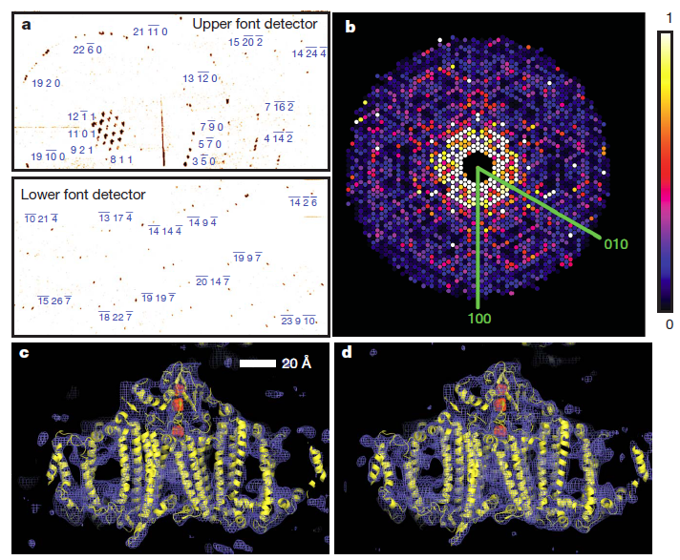
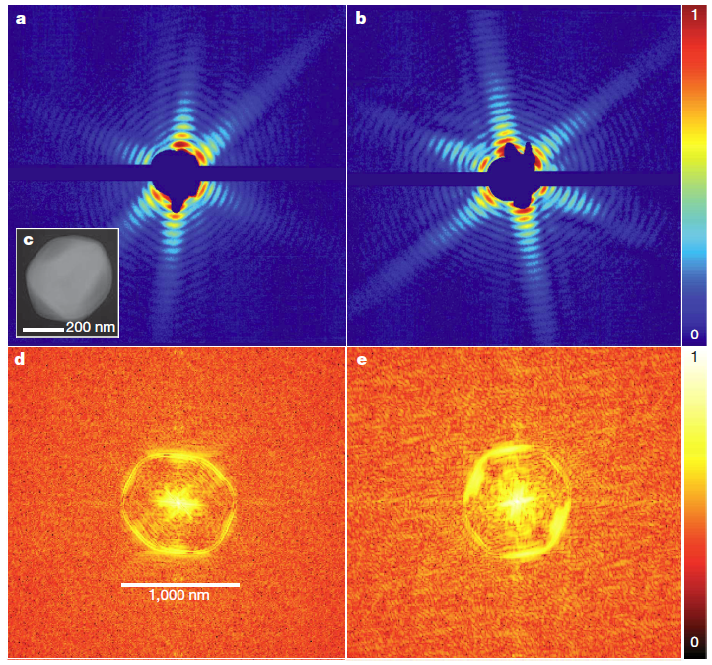
Requirements for High-Peak-Power FEL
Recent results on single pulse coherent diffraction imaging of proteins and viruses using an X-ray free electron laser (FEL) show that the resolution can be improved by both increasing the number of the coherent photons and simultaneously reducing the pulse duration, i.e.10 fs or less, one TW or larger.
Protein nano-crystallography
H.N. Chapman, et al., Nature 470, 73-77 (2011)
Single shot diffraction patterns on virus particles
N.M. Seibert, et al., Nature 470, 78-81 (2011)

Slide 3
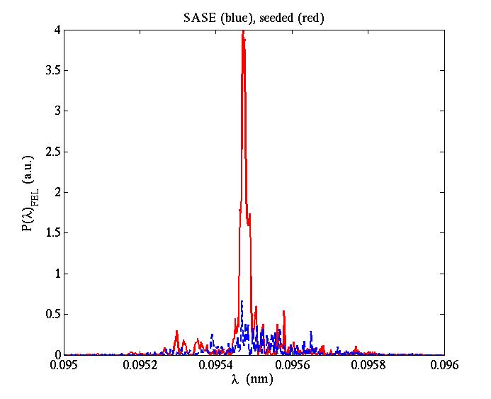
Tapered FEL Following Self-Seeding
Courtesy of Juhao Wu
4 m
e⁻ chicane
200 m
30 m
1st undulator
2nd undulator with taper
20 GW
1~5 MW
1TW
SASE FEL
Single crystal: C(400)
Self-seeded tapered FEL
e⁻
e⁻ dump
At the entrance
The monochromatic radiation pulse is recombined with the e-beam, and amplified.
The seed power is dominant over the equivalent shot noise power.
Seeded
10 fs,
1 TW
Small bandwidth.
SASE
Great idea from DESY (Geloni, Kocharyan, Saldin, DESY 10-133, Aug. 2010)
Notes:
Do not address much on the self-seeding scheme, just focus on the second undulator.
We call it as “self-seeded tapered FEL” to extract as much energy as possible from
The electron beam.

Slide 4
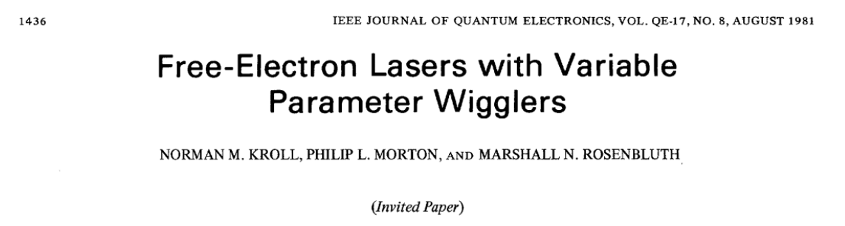
Limitation of the Energy Extraction Efficiency
Studies with three-dimensional (3D), time-dependent codes GENESIS and GINGER suggest that the available energy extraction efficiency is limited by some combination of diffraction, refraction, radial dependence of the radiation field, and time-dependent, slippage effects.
The energy transfer from the electrons to the radiation is below that is predicted by the 1D KMR theory , suggesting one can not only consider the longitudinal dynamics.
We develop a model extending KMR 1D theory to include the physics of diffraction, optical guiding, and radially-resolved particle trapping, with the aim to look insight the FEL process in a tapered FEL, and clarify how these effects combine together.
Notes:
With the aim to look insight the FEL in a tapered FEL, and clarify how these effects combine together.

Slide 5
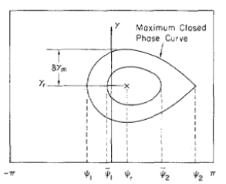
KMR Hamiltonian Approach
1D Hamiltonian formulation, take analogy between the FEL process and radio frequency accelerator.
Synchronous energy and phase
Larger Ψ_{r}, smaller F_{t}; Ψ_{r} = 0, F_{t}=1; Ψ_{r} = π/2, F_{t}=0
γ
stable
unstable
γ_{r}
Assume electrons uniformly distribute along Ψ dimension, the electron trapping fraction is
−π
Ψ₁
Ψ_{r}
Ψ₂
π
Notes:
They use synchronous energy gamma_r, synchronous phase Psi_r and Ft to characterize
The longitudinal ponderomotive motion.
Outside the bucket, electrons will not be trapped by the ponderomotive potential, while
Inside the bucket, the ponderomotive motion is stable.
One can calculate the max. and min. Psi for the bucket boundary. With the assumption that
Electrons distribute uniformly along Psi dimension, the electron trapping fraction
Ft equal to (Psi_2 – Psi_1)/2pi, is in terms of Psi_r.
In this way, one do not need to know information of individual electrons.

Slide 6
Optical Guiding Approach
Scharlemann, Sessler, and Wurtele [Phys. Rev. Lett. 54, 1925 (1985)] highlighted the fact that the light being amplified in a FEL can be refracted toward the axis by the electron beam. It looks like the light mode is guided by the electron beam (optical guiding).
By taking analogy of guiding of light by optical fiber, they define an effective complex index of refraction n,
and a fiber parameter V by V² = (n² - 1)k_{s}²r_{b}².
They showed that for a tapered FEL,
In the exponential gain regime, gain guiding dominates, Re(n) ~ 0.
After this regime, Im(n) ~ 0, while Re(n) describing the refractive guiding, dominates.
Notes:
w_{p} is the electron plasma frequency, w_{s} = k_{s}c is the radiation frequency, with l_{s} = 2p/k_{s} the radiation wavelength and c the speed of light, r_{b} is the electron beam radius, a_{w} = |e|B_{w}/k_{w}mc² and a_{s} = |e|A_{s}/mc² are the normalized vector potentials of the helical undulator and on-axis radiation field (an additional 2^{1/2} factor in denominator for a linearly polarized undulator), with e the elementary charge, mc² the rest mass energy of electron, B_{w} the undulator field amplitude and l_{w} = 2p/k_{w} the undulator period, [JJ] = 1 for helical undulator and [JJ] = J₀(k)-J₁(k) for linearly polarized undulator with k = a_{w}²/2(1+ a_{w}²), g is the electron’s Lorentz factor, Y is the electron phase relative to the ponderomotive potential, and quantities with subscript 0 indicate the initial electron and radiation beam parameters. The free space surrounding the electron beam, by contrast, has a refraction index of 1.

Slide 7
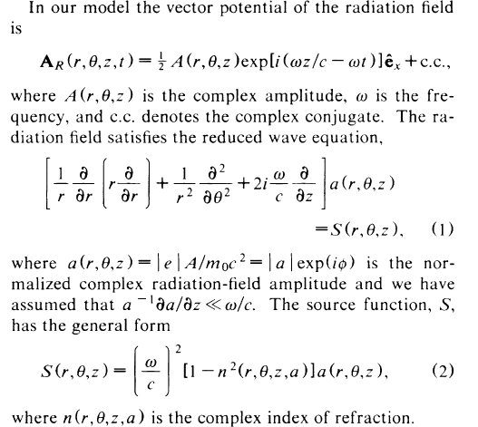
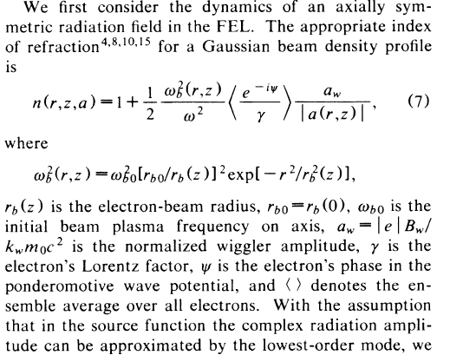
Optical Guiding and Focusing
Sprangle, Ting, and Tang [Phys. Rev. Lett. 59, 202 (1987)] used the so-called “source-dependent expansion (SDE)” approach to obtain a general, self-consistent formalism to describe the phenomena of radiation guiding and focusing in FEL.
With assumptions that the radiation beam profile remains approximately Gaussian, they obtain an envelope equation for the radiation beam,
with the optical focusing parameter K² in terms of V², G, Ψ
--- filling factor.
--- after the exponential gain regime.
Ψ ---ponderomotive phase of the electrons.
Notes:
Solve the wave equation, with the source function in terms of the complex index of refraction.
They also consider Gaussian E-beam density profile and assume fundamental Gaussian radiation mode
Dominates.

Slide 8
Radially-Resolved Physical Model
Slicing treatment in radial dimension
Ignore betatron motion
y
Same energy
At a specific r_{max}, Ψ_{r}(r_{max}) = π/2,
F_{t} = 0.
x
Uniform ditrib. in Ψ
each slice
<e^{-iΨ(r)}> = e^{-iΨr(r)} each slice
At different radial position r, electrons experience different radiation field amp., the ponderomotive poential is different, Ψ_{r}(r) is different, bucket size is different, and therefore local trapping fraction F_{t}(r) is different.
Electrons at different r have different detrapping rate, and detrap more rapidly at larger radius. The overall F_{t} and <e^{-iΨ}> is calculated by taking average over r.
Notes:
The transverse distribution of trapped electrons will deviate some from a Gaussian profile in the tapered region.

Slide 9
Formulation of our Physical Model
1, Energy conservation
F_{t}(z), γ(z), r_{b}(z), <cosΨ>(z)
<sinΨ>(z)
2, Envelope equation for radiation field
3, E-beam (trapped) energy variation (ignore energy spread ~ ρ), γ(z) = γ_{r}(z)
4, E-beam (trapped) synchronous phase, depends on r
a_{w}(z), a_{s0}(z), r_{s}(z)
5, Radially-resolved local electron trapping fraction
6, Overall electron trapping fraction and microbunching term

Slide 10
Property of our Physical Model
It combines the KMR analysis and optical guiding approach with explicit formulation.
It adopts radially-resolved synchronous phase and local electron trapping fraction to couple the longitudinal and transverse dynamics.
Since the model is not derived strictly from Maxwell equations, it well describes the evolution of the radiation field within r_{max}, more or less 3r_{b0}, while not considering the radiation propagating outside this region.
To simplify the analytical study, it is assumed that the undulator is tapered from the initial saturation location.
At initial saturation (the end of the exponential gain regime), P_{sat} ≈ ρP_{beam}, we have approximately r_{s,sat} = r_{b0}, Ψ_{r,sat} = 0, F_{t,sat} =1, γ_{sat} = γ₀, a_{w,sat} = a_{w0}, and
Given a taper profile a_{w}(z) ) [and r_{b}(z)] and values of (a_{s0,sat}, r_{s,sat}, Ψ_{r,sat}, F_{t,sat}), one can iterate the equations to evolve those parameters in z along the undulator.
Notes:
Without any help from numerical code.

Slide 11
GENESIS Scan with LCLS-II Like Parameters
LCLS-II like parameters
Fixed taper start-point z₀ = 12 m,
GENESIS scan taper ratio ξ = 1-a_{w}(L_{w})/a_{w}(z₀),
and electron beam radius r_{b}
Parameters | Value | Unit
E-beam energy | 13.64 | GeV
E-beam current | 4000 | Ampere
Normalized emittances ε_{x, n}/ ε_{y, n} | 0.3/0.3 | μm-rad
Energy spread | 1.3 | MeV
E-beam pulse length (FWHM) | 10 | fs
Normalized undulator parameter a_{w0} | 2.3832
Undulator period λ_{w} | 3.2 | cm
Undulator length L_{w} | 120 | m
Radiation wavelength λ_{s} | 1.5 | Angstrom
Peak radiation input power P_{in} | 5 | MW
Max. power of 2.2 TW with ξ = 0.12 and r_{b} = 15 mm, Case A
Radiation power depends on both the taper profile and transverse focusing,
Achieving high radiation power requires strong transverse focusing.
Notes:
Xi measures the relatively reduction of the undulator filed, as well as the relatively reduction
Of the electron energy.

Slide 12
Verification of the Physical Model (Case A)
Evolution of radiation power (within 3r_{b}), on-axis radiation field a_{s0}, radiation beam radius r_{s}, trapping fraction F_{t} with z.
Solid lines : GENESIS
single-frequency
simulation
Dashed lines :
Physical model

Slide 13
Verification of the Physical Model (Case A)
Transverse distribution of radiation field, trapped electron No., and Ψ_{r} (or <Ψ> from GENESIS) at z = 50 m.
Initial distrib.
Solid lines : GENESIS
single-frequency
simulation
Dashed lines :
Physical model
Notes:
Considering the assumptions made in the model, the agreement between the model and GENESIS simulation
is pretty good.

Slide 14
Applications of the Physical Model
The physical model enable us
to understand the mechanism of saturation of the radiation intensity and power, the decreasing of refractive guiding and trapping fraction is the major cause.
to understand that a controlled variation in electron beam radius (transverse focusing) can be helpful in improving the overall energy extraction efficiency.
to propose multi-dimensional optimization scheme
  Eight parameters, z₀, d, ξ, z₁, z₂, K_{q}(z₁), K_{q}(z₂) and K_{q}(L_{w})

Slide 15
200 m Hard X-ray FEL w/o Break Sections
Optimization with r_{b}-variation (red) vs. with constant r_{b} (green). Higher power, 4.9 TW vs. 4.4 TW, increase by 11%,
Higher on-axis radiation field, small radiation radius; higher F_{t}.

Slide 16
200 m Hard X-ray FEL w/Break Sections, 1m/4.4m
Optimization for FEL w/o break-section (red) vs. with/break section (black).
Power reduction, 46% (from 4.9 TW to 2.7 TW), partially due to less magnetic length (23% reduction), partially due to vacuum diffraction of radiation in break sections.
Increase in r_{s} and reduction in a_{s0}, cascade into increase in Ψ_{r} and decrease in F_{t}.

Slide 17
Impact of Sideband Growth in Hard X-ray FEL
200 m Hard X-ray FEL w/o break sections with time-dependent effects (blue) vs. w/o time-dependent effects (red).
---time-dependent effects lead to significant detrapping by around 100 m, and the average radiation power and on-axis |a_{s}| reach saturation much earlier in z and, most importantly, at much smaller values than is true for the single-frequency run.

Slide 18
No Seed vs. Seeded Power Spectrum
SASE: blue
Seeded: red

Slide 19
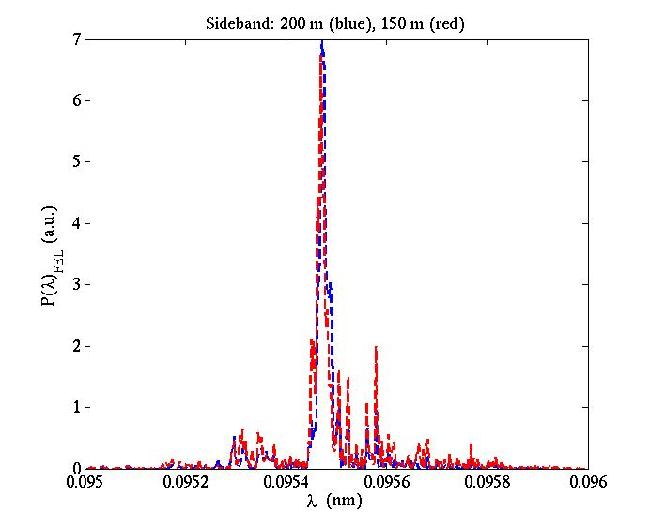
Seeded, Sideband Spectrum

Slide 20
Conclusions
A new physical model of tapered FEL, has good success in predicting the behavior with z of the electron and radiation beams;
Multi-dimensional optimization based on GENESIS single-frequency simulations;
A reasonable variation of the transverse focusing can to some extent further enhance energy extraction efficiency.
Preliminary study for the impact of the sideband growth.
A general description of FEL process and saturation mechanism; Dependence of the available max. radiation power on various parameters(not shown here).

Slide 21
Thanks for Your Attention!

Slide 22
Backup slices

Slide 23
KMR vs. SDE vs. Our Model
 | KMR | SDE | Our Model
Radiation beam | No transverse variation, Radiation field and e-beam overlap perfectly r_{s}=r_{b}=const. Only consider variation of a_{s} with z Energy conservation F_{t} : trapped electron No./total electron No. | Solve the evolution of the field from wave equation, whose source function is in term of n. Basic assumption is that fundamental mode dominates (i.e. radiation beam profile remains approximately Gaussian) | Consider only the fundamental mode Energy conservation Envelope equation
Tapered region | Synchronous energy (aver. energy of the trapped electrons) | Numerical simulation to get the mircobunching term <e^{-iΨ}/γ>, which contains F_{t} information | Same with KMR treatment
Notes:
I will clarify the difference in these aspects one by one. The KMR ignore any transverse
Variation in electron density and radiation beam. The key point of their analysis to describe
The ponderomotive motion of electron with the well-know RF bucket parameters.(show the third slides).
SDE approach considers Gaussian profile for the radiation and electron transverse distribution,
Thus it include effects from the transverse dimension. However, because they do not adopt the
Synchronous ponderomotive phase termilonogy, they must program codes to calculate Psi for each
Particle and then take average to obtain the microbunching term.
Basically, we adopt the KMR analysis for the longitudinal dynamics, but consider transverse Gaussian
Profile, thus the longitudinal parameters, Psi, Ft are coupled with transverse dimension parameters,
Like the radial position, r.

Slide 24
KMR vs. SDE vs. Our Model (cont.)
 | KMR | SDE | Our Model
E-beam Transverse dimension | Const. radius r_{b} Uniform transverse density | Gaussian beam density profile | Same with SDE treatment for the initial distribution, which will deviate from Gaussian with taper.
E-beam Longitudinal dimension | A portion (F_{t}) of electrons oscillate around γ_{r} and Ψ_{r} | Numerical simulation to get Ψ and γ for each particle | Similar to KMR treatment Mono-energy; since a_{s} depends on r, Ψ_{r} depends on r.
Electron trapping fraction F_{t} | Ψ₂, Ψ₁ are the max. and min. Ψ of the ponderomotive bucket | Numerical simulation to get the mircobunching term <e^{-iΨ}/γ>, which contains F_{t} information | Same with KMR treatment local trapping fraction F_{t}(r, z) depends on r,

Slide 25
FEL process in a tapered FEL
The decreasing of refractive guiding and trapping fraction is the major cause of the saturation of the radiation intensity and power.
The tapered undulator system, from the initial saturation location to the end, three successive regions.
Particle Trapping Development Region @I
V² > 1, G ~ 0, rapid r_{s} growth, evident detrapping.
Radiation Intensity Growth Region @II
V² > 1, G ~ 1, slow r_{s} growth, strong a_{s0} increase.
Radiation Power Growth Region @III
V² < 1, G ~1, rapid r_{s} growth, a_{s0} decreases,
power still grows.
I
II
III
Case A

Slide 26
Particle Trapping Development Region
This region starts from initial saturation and lasts ~ 2 Rayleigh lengths (2z_{r}).
At the beginning, r_{s} ≈ r_{b}, G ~ 0. The -1 term dominates the expression for K², leading to strong diffraction of the radiation and an increase in r_{s}.
The energy conservation has equivalent form
The increase in r_{s} corresponds to a large ΔE_{r}(rad), suggesting a large portion of the energy extracted from the electron beam contributes to the radiation expansion in radial direction.
As r_{s} increases, G also increases. By the end of this region, G is large enough that the V²G ≥ 1, and the optical focusing effects now become strong. At this point the r_{s} growth becomes much slower and a_{s0} will begin to increase strongly.

Slide 27
Particle Trapping Development Region (Cont.)
At taper start-point, a_{w}’ = 0; then |a_{w}’| will be increased, the ponderomotive bucket evolves with the on-axis Ψ_{r} increasing from 0 to a positive value, and with F_{t} decreasing markedly.
Electrons gradually bunch themselves to match the changed ponderomotive bucket, during which evident detrapping occurs.
For case A (right), z_{r} = 4.7 m, 2z_{r} after initial saturation, the trapped electrons have a visible reduction in the average beam energy, and F_{t} decreases by about 17%.
At initial saturation
1z_{r} after initial saturation
2z_{r} after initial saturation

Slide 28
Radiation Intensity Growth Region
This region follows the particle trapping development region and ends where a_{s0} reaches a maximum value.
In this region, G ~1, V² > 1, (-1+ V²G) dominates the expression of K². Radiation focusing is relatively strong, r_{s} increases slowly and a_{s0} increases rapidly.
Meanwhile, the increase in a_{s0} causes a reduction in V², and hence a decrease in K², i.e. reduced optical focusing. r_{s} increases more and more rapidly.
The a_{s0} growth gradually slows down, in general eventually reaching an asymptotic value (ΔE_{r}(rad) = ΔE(e-) , at V²~1, K² ~0).
The length of this radiation intensity growth region can be estimated by
L_{rigr} ≈ (a_{s0, max}–a_{s0, sat})/<a_{s0}’>,
with <a_{s0}’> being the average a_{s0} growth rate in this region.

Slide 29
Radiation Intensity Growth Region (Cont.)
In general, it requires a moderate taper to obtain both large on-axis intensity and large power.
Black, strong taper,
= 0.16
Red, moderate taper
ξ = 0.12
Blue, gentle taper
ξ = 0.02

Slide 30
Radiation Power Growth Region
This region following the radiation intensity growth region, where the on-axis intensity does not increase but the total radiation power still grows. Note that in the case that a_{s0} has not reached the predicted a_{s0,max} at the end of the undulator, there will not be such a region.
V² < 1, r_{s} increases rapidly, a_{s0} decreases with z (in some cases, the a_{s0} decrease rate can be small). However, the radiation power will continue to increase as long as there exist electrons trapped in the ponderomotive bucket.
Associated with the weakened refractive guiding, the energy extraction becomes less and less efficient, independent of the actual taper profile.
---Case I: KMR-based self-design taper algorithm, a design particle at a preset radius remains at a constant Ψ_{r}, F_{t} will decease slowly, but will reach power saturation within a long enough ndulator.
--- Case II: A taper with smaller |a_{w}’| compared with Case I, it will needs even longer undulator length to reach power saturation.
---Case III: A taper with larger |a_{w}’| compared with Case I, can produces relatively slower decrease in a_{s0} within a short distance from the beginning of this region.

Slide 31
Optimization of a finite-length tapered FEL
Optical guiding physics limits the on-axis radiation intensity and the overall energy extraction efficiency.
Generally, to maximize the overall energy extraction efficiency usually requires a moderate taper within a long enough undulator length, let us say L_{w} ≥ L_{sat} + 4z_{r}, which results in a relatively large a_{s0, max} before and close to the exit of the undulator.
The optical focusing and hence the evolution of the radiation beam is related to both the longitudinal dynamics (through |γ_{r}’| and Ψ_{r}) and the transverse dimension parameters (through G), it is interesting to consider if allowing a controlled variation in the electron beam radius (transverse focusing) can be helpful in improving the overall energy extraction efficiency.

Slide 32
Contribution of Variation in Transverse Focusing
We consider a gradually decreased r_{b} (increasing transverse focusing) in the latter part of a tapered undulator, and compare with the case with the same taper profile but constant r_{b}.
The factor G and K² will be slightly larger, leading to increased optical focusing and to smaller r_{s} & smaller ΔE_{r}(rad). Thus a larger portion of energy contributes to a_{s0} growth.
A larger a_{s0}, results in smaller Ψ_{r}(r=0) and higher F_{t}(r=0). On the other hand, a smaller r_{s} leads to a smaller r_{max}, causing higher Ψ_{r}(r) and smaller F_{t}(r) for electrons at large r. More electrons around axis will be trapped, resulting in stronger on-axis optical guiding will tend to lead to a more rapidly growing a_{s0}.
If squeezing r_{b} too much, diffraction effect dominates. Thus, there is an optimal value for the decreased r_{b}.
The change in G is small, thus improvement from an r_{b}-variation is relatively small.

Slide 33
Multi-Dimensional Optimization Scheme
Taper profile
z₀ the taper start-point, d the taper profile order, c is the scale coefficient which is related to the taper ratio ξ by c = ξ/(L_{w}-z₀)^{d}.
Empirically it is best to start the taper slightly before initial saturation and use a moderate taper profile order with d ≈ 2. The optimal ξ for the maximum radiation power varies with the undulator length and various initial electron and radiation beam parameters.
Quadrupole strength 3-segment variation
z₁, z₂ indicate the K_{q} variation points, z₁ usually around initial saturation and z₂ around where a_{s0} reach its maximum value.
The coefficients f can be either positive or negative, while g is usually negative.

Slide 34
Multi-Dimensional Optimization
We perform multi-dimensional scans with GENESIS single-frequency simulations over the following eight parameters, z₀, d, ξ, z₁, z₂, K_{q}(z₁), K_{q}(z₂) and K_{q}(L_{w}) to obtain the maximum radiation power for a tapered FEL with specific electron beam, radiation seed and undulator properties.
Matlab code run in Windows system.
The code generates input file, invokes GENESIS simulation via Cygwin, and reads GENESIS output.
The parameter scan is performed by varying one parameter while fixing the other seven.
The variation of the radiation power with respect to a specific parameter can be obtained and the optimal value is then found by means of data analysis.
Two Applications
200 m, hard X-ray FEL, LCLS-II like parameters, without break sections.
  Clarify the contribution of variation in r_{b}.
200 m, hard X-ray FEL, LCLS-II like parameters, with break sections.
  Clarify the effect of the finite-length break sections.

Slide 35
200 m Hard X-ray FEL w/o Break Sections
Optimization with r_{b}-variation (red) vs. with constant r_{b} (green). Higher power, 4.9 TW vs. 4.4 TW, increase by 11%,
Higher on-axis radiation field, small radiation radius; higher F_{t}.

Slide 36
200 m Hard X-ray FEL w/Break Sections, 1m/4.4m
Optimization for FEL w/o break-section (red) vs. with/break section (black).
Power reduction, 46% (from 4.9 TW to 2.7 TW), partially due to less magnetic length (23% reduction), partially due to vacuum diffraction of radiation in break sections.
Increase in r_{s} and reduction in a_{s0}, cascade into increase in Ψ_{r} and decrease in F_{t}.

Slide 37
Dependence of the Available Maximum Radiation Power on Various Parameters
Initial electron beam parameters
Approximately quadratically with the initial beam current,
Linearly with the initial beam energy,
The smaller the emittance and energy spread of the electron beam, the larger the maximum extractable radiation power.
Input radiation field parameters
The impact of the radiation seed parameters, such as the radiation input power and the initial spot size, is relatively small, especially when the seed power exceeds a specific value (e.g., 1 MW for LCLS-II).
Undulator system parameters
Helical undulator produces higher radiation power than linearly polarized undulator, by a factor of about 1/[JJ]²;
An undulator with shorter break sections produces higher radiation power;
A longer undulator can be optimized for higher maximum radiation power and performs best with a taper with smaller |a_{w}’| relative to what is true for shorter undulators.
In Absence of Sideband Growth

Slide 38
Impact of Sideband Growth on Optimization
Sideband growth generally occurs after initial saturation and will be excited by the SASE components which grow in the exponential gain regime and originate from the shot noise on the electron beam.
From the viewpoint of energy conservation, the sidebands’ power accumulates along the undulator associated with the slowly varying |a_{s}| in the tapered region, generally reducing the energy gain of the primary wave and causing a more rapid detrapping due to the resultant decrease of longitudinal coherence.
Eventually, these all lead to saturation of the radiation power at a much earlier point in z than would be true in their absence.
A systematic theoretical and simulation analysis of these effects is under way.

Slide 39
Impact of Sideband Growth in Hard X-ray FEL
200 m Hard X-ray FEL w/o break sections with time-dependent effects (blue) vs. w/o time-dependent effects (red).
---time-dependent effects lead to significant detrapping by around 100m, and the average radiation power and on-axis |a_{s}| reach saturation much earlier in z and, most importantly, at much smaller values than is true for the single-frequency run.

Slide 40
Conclusions
A new physical model of tapered FEL, has good success in predicting the behavior with z of the electron and radiation beams;
A general description of FEL process and saturation mechanism;
Multi-dimensional optimization based on GENESIS single-frequency simulations;
A reasonable variation of the transverse focusing can to some extent further enhance energy extraction efficiency;
Dependence of the available max. radiation power on various parameters;
Preliminary study for the impact of the sideband growth.

Slide 41
Averaging F_{t} over Thousands of Slices

